Slide 1
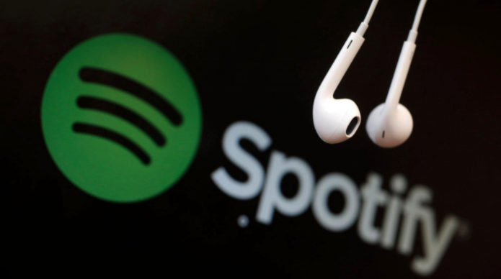
Visualizing Spotify Music Trends

Slide 2





Team Ex-penn-DATAbles
Aaron “Shotgun” Lee
Jeff “Galgo” Toussaint
Jeremy “Christmas” Strauch
Tianchi “Yin Yang” Zhang
Notes:
Jeff (5s)

Slide 3
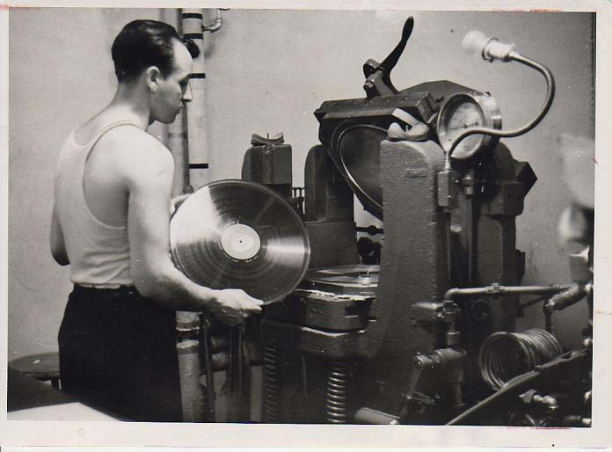
Finding Data
Data Source: Kaggle (Spotify Dataset 1920-2020, 160k+ Tracks)
Background:
The story of sound recording, and reproduction, began in 1877, when the man of a thousand patents, Thomas Edison, invented the phonograph.
The commercialized music industry has only been around for about 100 years as the recording and radio technology emerged in the early 90s.
Core message:
Objective: Uncover music trends. Understand how artists, genres, the features of audio and the popularity of songs developed through time.
The Acoustic era (1877–1925)
The Electrical era (1925–1945)
The Magnetic era (1945–1975)
The Digital era (1975–Present)
Source: Charm
Source: Wikipedia
Notes:
Tianchi (20s)

Slide 4
Developing Questions
From which era are the songs most popular now? (Tianchi)
Who are the most “timeless” artists? (Tianchi)
How do popular genres compare with each other? (Jeremy)
How have the audio features changed over time? (Jeff)
How has people’s music taste developed? (Jeff)
Is there any correlation between audio features? (Aaron)
Is there a way to predict popularity given audio features? (Aaron)
How can Spotify leverage the data? (Jeff)
Notes:
Tianchi - 5 angles
Describe the questions you and your group found interesting, and what motivated you to answer them…
Describe the questions you asked, and why you asked them…
When talking to each question, might need to give a very high level summary of the findings...
Ideas to work on:
High-level descriptive analysis of the entire dataset → Tianchi
Who are the most timeless artists? → Tianchi
Code:
a = df.groupby('artists')['year'].max() - df.groupby('artists')['year'].min()
plt.hist(a)
plt.yscale('log')
a.sort_values(ascending=False).head(20)
Which genre is the loudest? Is it rock-and-roll? (top 10 loudness by genre in a bar chart) → Dan (?)(which genre is most danceable?
How have the attributes changed over the years? Which attribute is growing in popularity and which one is fading away? → Jeff
YoY analysis on songs → Jeff
Are contemporary songs less danceable? (danceability by binned years in a time series) → Tianchi
Number of songs collected per year → Aaron - Completed
All with all correlations (creating the correlation map between each attribute, the objective of this is to see if any of the song characteristics correlate with each other. The exact code is in this link) → Aaron/Tianchi - Completed
Which attribute is most important for making a song popular? → Aaron/Tianchi - Completed
Someone to clean up the dataset → Tianchi, Jeff - Completed
Artist with the most number of songs → Jeremy
Expand on the why? - dashboard view
All the attributes plotted over the years by using binning function - Jeremy

Slide 5
~175,000
1921-2021
30,000+
9
3,000+
4
Total Count of Songs
Data Timeframe
Total Count of Artists
Audio Features
Total Count of Genres
Beginner Analysts
Notes:
Jeff (15s)

Slide 6
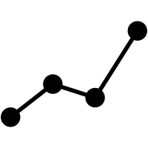
Data Dimensions
19
Total Variables
Audio Features
Objective Facts
Acousticness (Ranges from 0 to 1)
Danceability (Ranges from 0 to 1)
Energy (Ranges from 0 to 1)
Speechiness (Ranges from 0 to 1)
Instrumentalness (Ranges from 0 to 1)
Valence (Ranges from 0 to 1)
Liveness (Ranges from 0 to 1)
Tempo (Float typically ranging from 50 to 150)
Loudness (Float typically ranging from -60 to 0)
Id (Id of track generated by Spotify)
Popularity (Ranges from 0 to 100)
Duration_ms (Integer typically ranging from 200k to 300k)
Year (Ranges from 1921 to 2020)
Artists (List of artists mentioned)
Name (Name of the song)
Mode (0 = Minor, 1 = Major)
Explicit (0 = No explicit content, 1 = Explicit Contents)
Key (All keys on octave encoded as values ranging from 0 to 11, starting on C as 0, C# as 1 and so on…)
Release_date (Date of release)
Notes:
Jeff
Characteristics that describes the music
The right side explains…
Since the decibel uses a human threshold as a constant, any sound pressure that is lower than the threshold of hearing will register as a negative decibel. ... Decibels are a unit of a logarithmic scale. Zero decibels are not zero sound (or any signal) level.

Slide 7
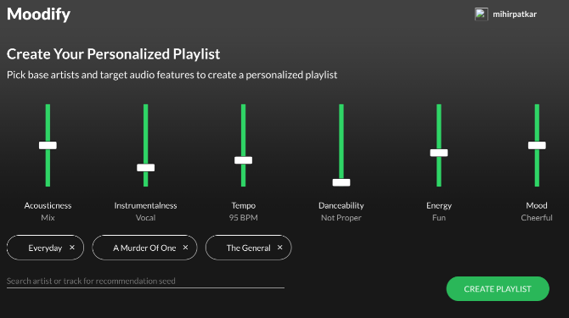
Audio Features
Acousticness - A confidence measurement from 0.0 to 1.0 of whether the track is acoustic.
Danceability - Describes how suitable a track is for dancing based on a combination of musical elements.
Energy - Measure from 0.0 to 1.0 and represents a perceptual measure of intensity and activity.
Instrumentalness - Detects whether a track contains no vocals. For instance, “Ooh” and “aah” sounds. The closer it is to 1.0, the greater the chances it contains no vocal content.
Speechiness - Detects spoken words in a track. Values above .0.66 describe tracks that are probably made entirely of spoken words.
Tempo - An estimated beats per minute. For example, the speed or pace of a track.
Valence - A measurement from 0.0 to 1.0 - Track will high valence are flagged as positive emotions whereas, low valence sound are more negative (i.e. sad, depressed).
Liveness - the presence of an audience in the track. For instance, above 0.8 produces a stronger likelihood that the track is live.
Notes:
Jeff
Talk about what does it mean when the score increase/decrease?
6. How can Spotify leverage the data?

Slide 8
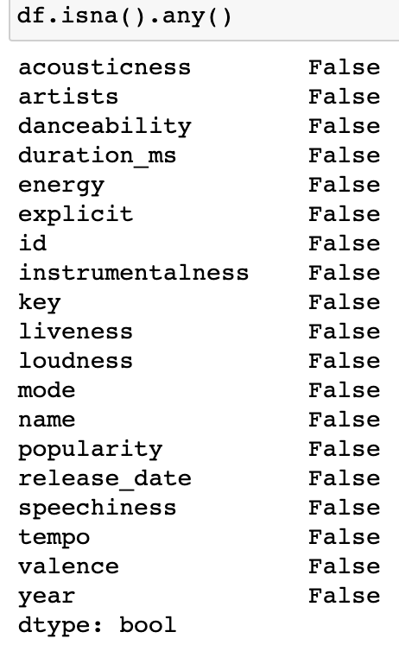
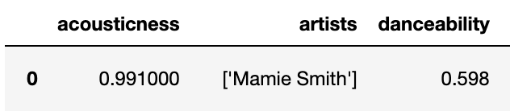
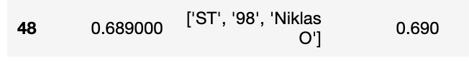
Data Cleaning/Descriptive Analysis
Data Cleaning:
No missing data
Data types are correct (int, float64, object)
No mixed data types
Artists are lists of values
Lists vary depending on number of collaborators
Delete unwanted fields
Descriptive Analysis:
Histograms: audio features, music characteristics, other
Notes:
Tianchi:
Cleaning, limitations, indications
Histograms

Slide 9
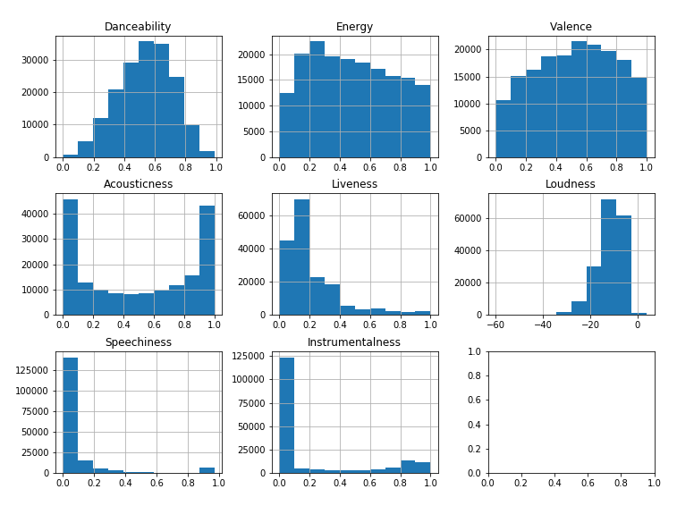
Audio Features
Notes:
Tianchi:
Most are from 0 to 1, except loudness

Slide 10
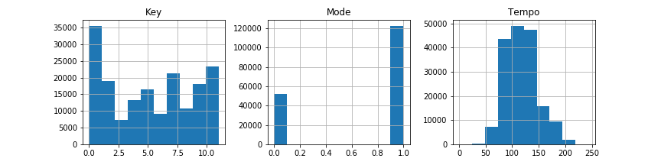
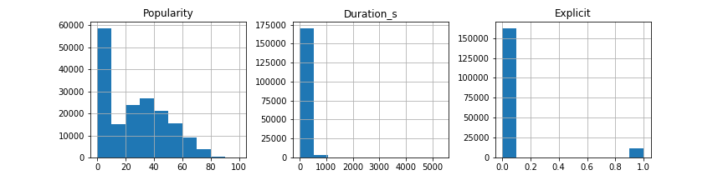
Music Characteristics
Other
Notes:
Tianchi:
Focus on “Popularity”

Slide 11

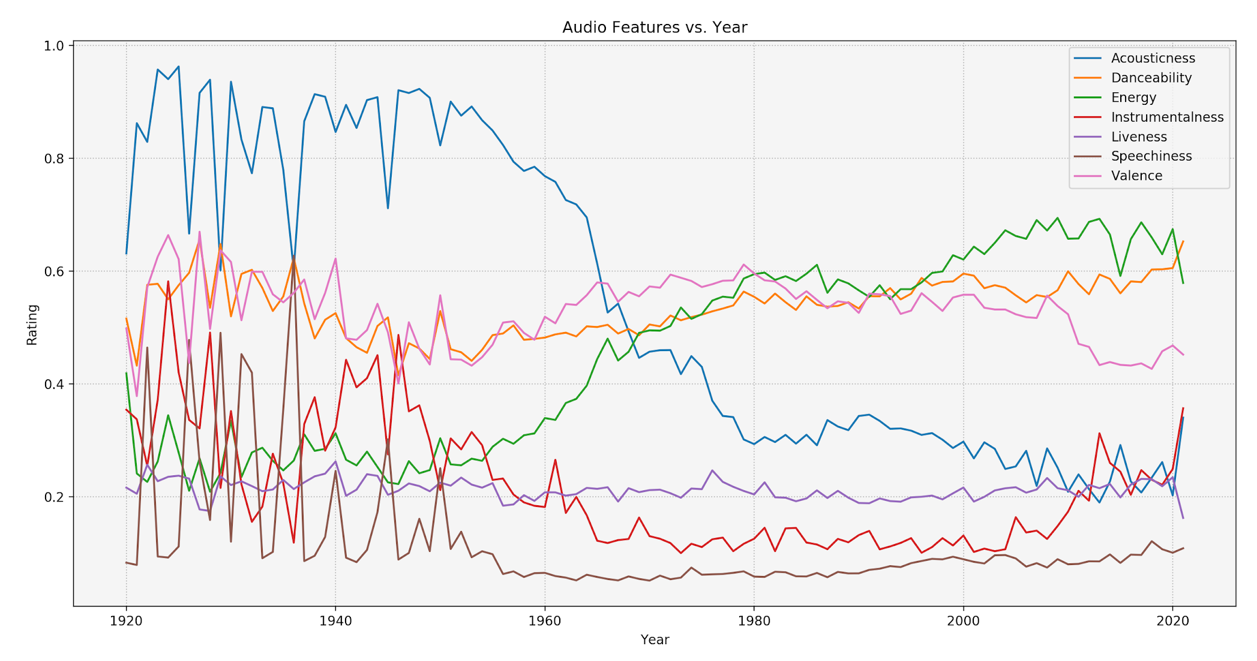
Analysis: Trends Over the Years
Notes:
Jeff/Jeremy
Possibly Factors:
There isn’t a clear definition of music at a time
The age of music and digitizing the music
People are trying different things
The size of the data sample (Song Count)

Slide 12
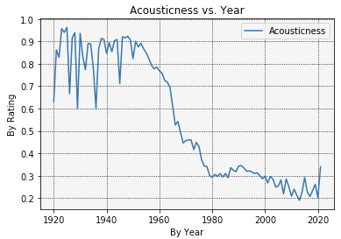
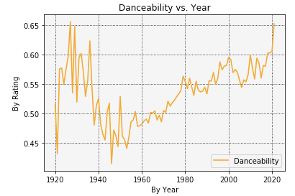
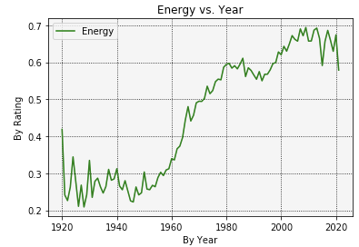
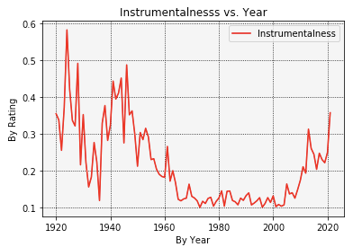
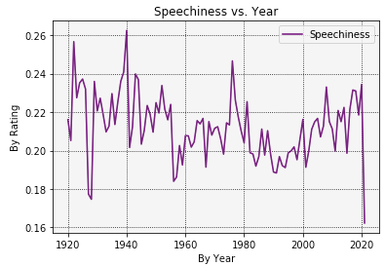
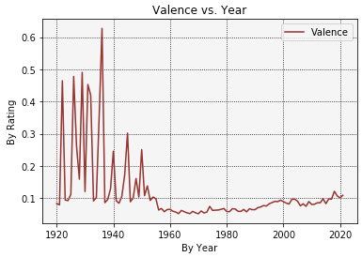
Acousticness dropped after 1960 after stabilizing around 30%
Danceability took a slight dip around 1940-1960, but later displays a positive uprise.
After 1940, Energy in within songs has been on the rise.
Instrumentalness proves to be sporadic between 1920-1960, but later stabilized with a increase spike.
Speechiness remains infrequent throughout the years with an average of 20%
Valence starts shifty but stays poised after 1960 with a baseline of 0.1
Time Series Analysis Dashboard
Notes:
Jeff/Jeremy
Analysis: trends over the years

Slide 13
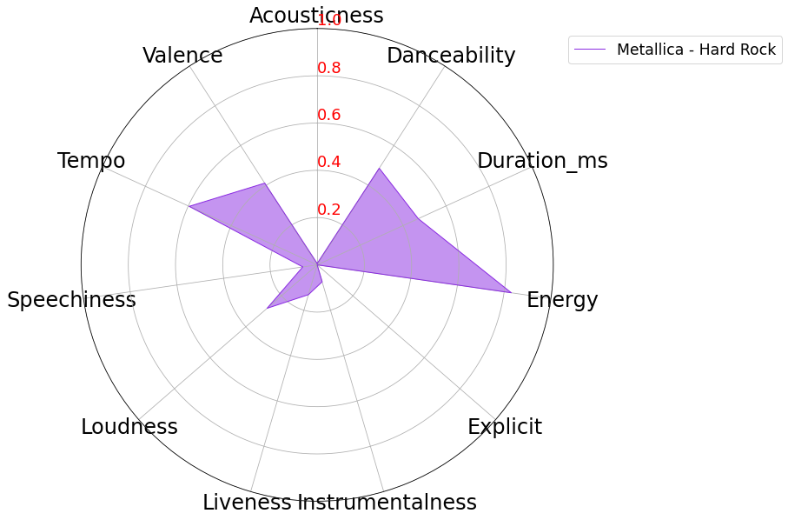
Analysis: Popular Genres
Major Question
How do song characteristics differ for major genres?
Radar Plot Comparison - Methodology
3,000+ genres defined in spotify; some artists span several genres
Genre lists in alphabetical order, not by major themes
Chose five of today’s artists from Billboard 200
Artists represent major genres themes
Compared averaged values for top 20 songs
Loudness, tempo, duration were normalized prior to plotting
Genres Explored
Hard rock, EDM, rap, dance and country
Metallica - Hard Rock
Surprises: danceability, explicit, loudness
Expected: valence, speechiness, accousticness, liveness, instrumentalness
Notes:
Jeremy

Slide 14
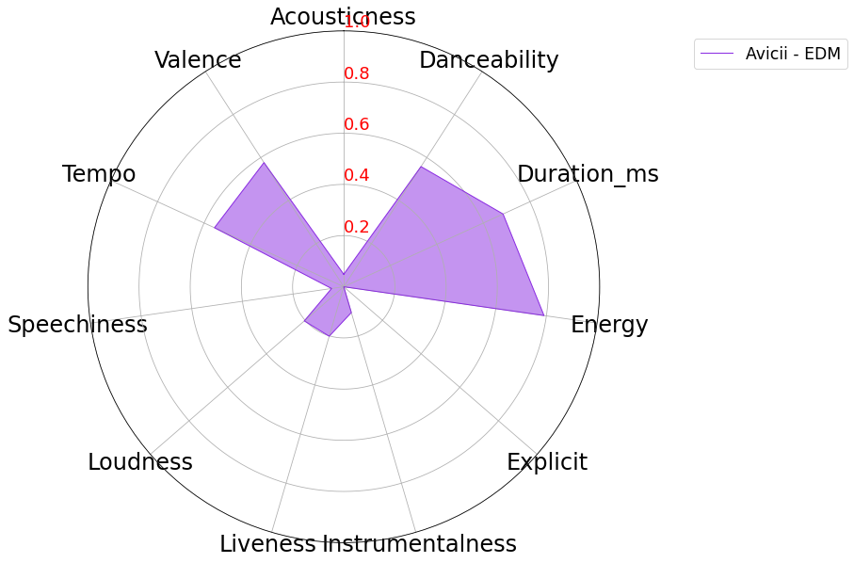
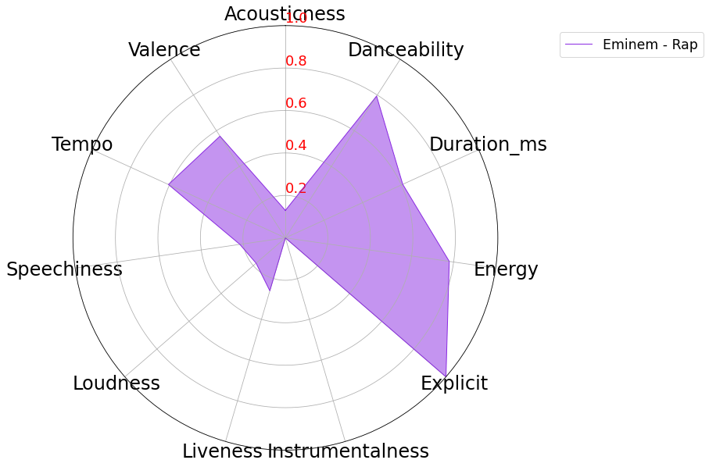
Analysis: Popular Genres
Avicii - EDM
Surprises: loudness
Expected: energy, speechiness, danceability, instrumentalness
Eminem - Rap
Surprises: valence, speechiness
Expected: explicit, danceability, tempo, energy
Notes:
Jeremy

Slide 15
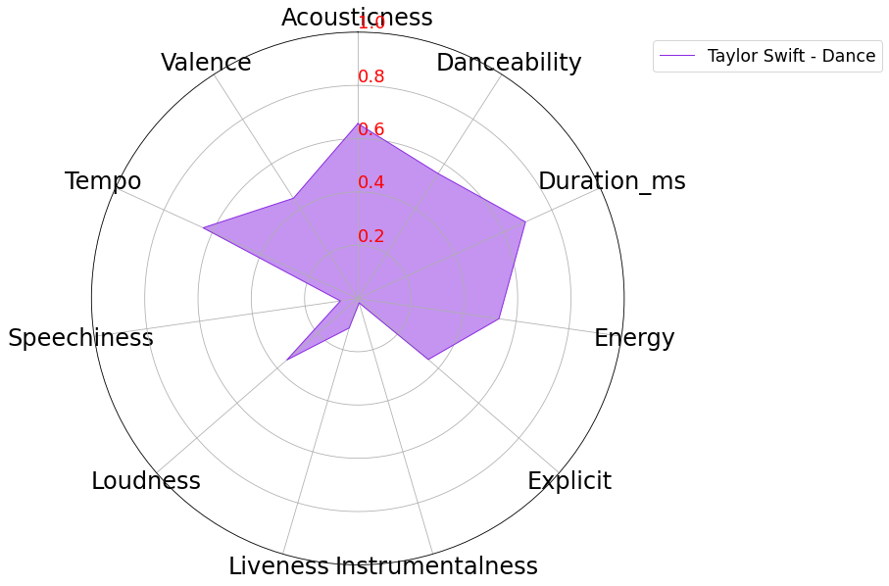

Analysis: Popular Genres
Taylor Swift - Dance/Pop
Surprises: explicit, loudness, accousticness, speechiness
Expected: lenergy, danceability, tempo
Blake Shelton - Country
Surprises: loudness, duration, accousticness, valence, danceability
Expected: liveness, speechiness, explicit
Notes:
Jeremy

Slide 16
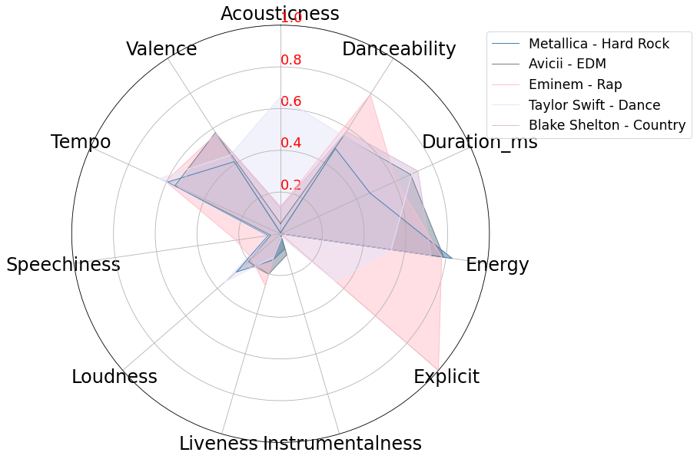
Analysis: Popular Genres - Summary
Summary of Popular Genre Characteristics
All genres chosen have low speechiness and low instrumentaliness
Live recorded music doesn’t appear to be popular option
Major differentiation amongst explicit and accousticness categories for at least two artists
Some delineation between valence and energy, but alignment amongst the genres
Song characteristics: evolved or manufactured?
Notes:
Jeremy

Slide 17
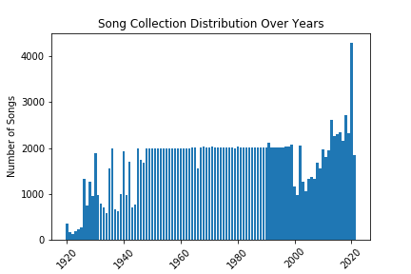
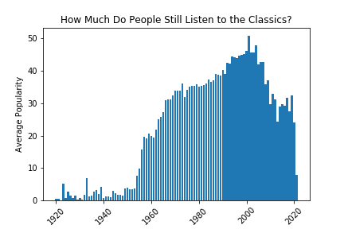
Analysis: How much do people still listen to the classics?
*As of March 2018, Spotify's user base was dominated by Millennials, with 29 percent of its users aged 25 to 34 and 26 percent aged between 18 and 24 years old.
Average
Source: Statista
Notes:
Tianchi:
People are nostalgic, it’s no different when it comes to music.
Music, just like art, takes time to be appreciated.
Since the popularity is all current, it’s extremely difficult to compare era to era. Speaking of era, the next question we asked ourselves was “Who is the goat of music?”

Slide 18
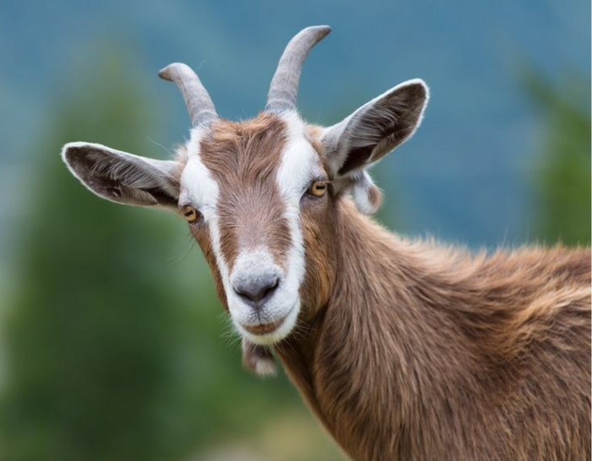

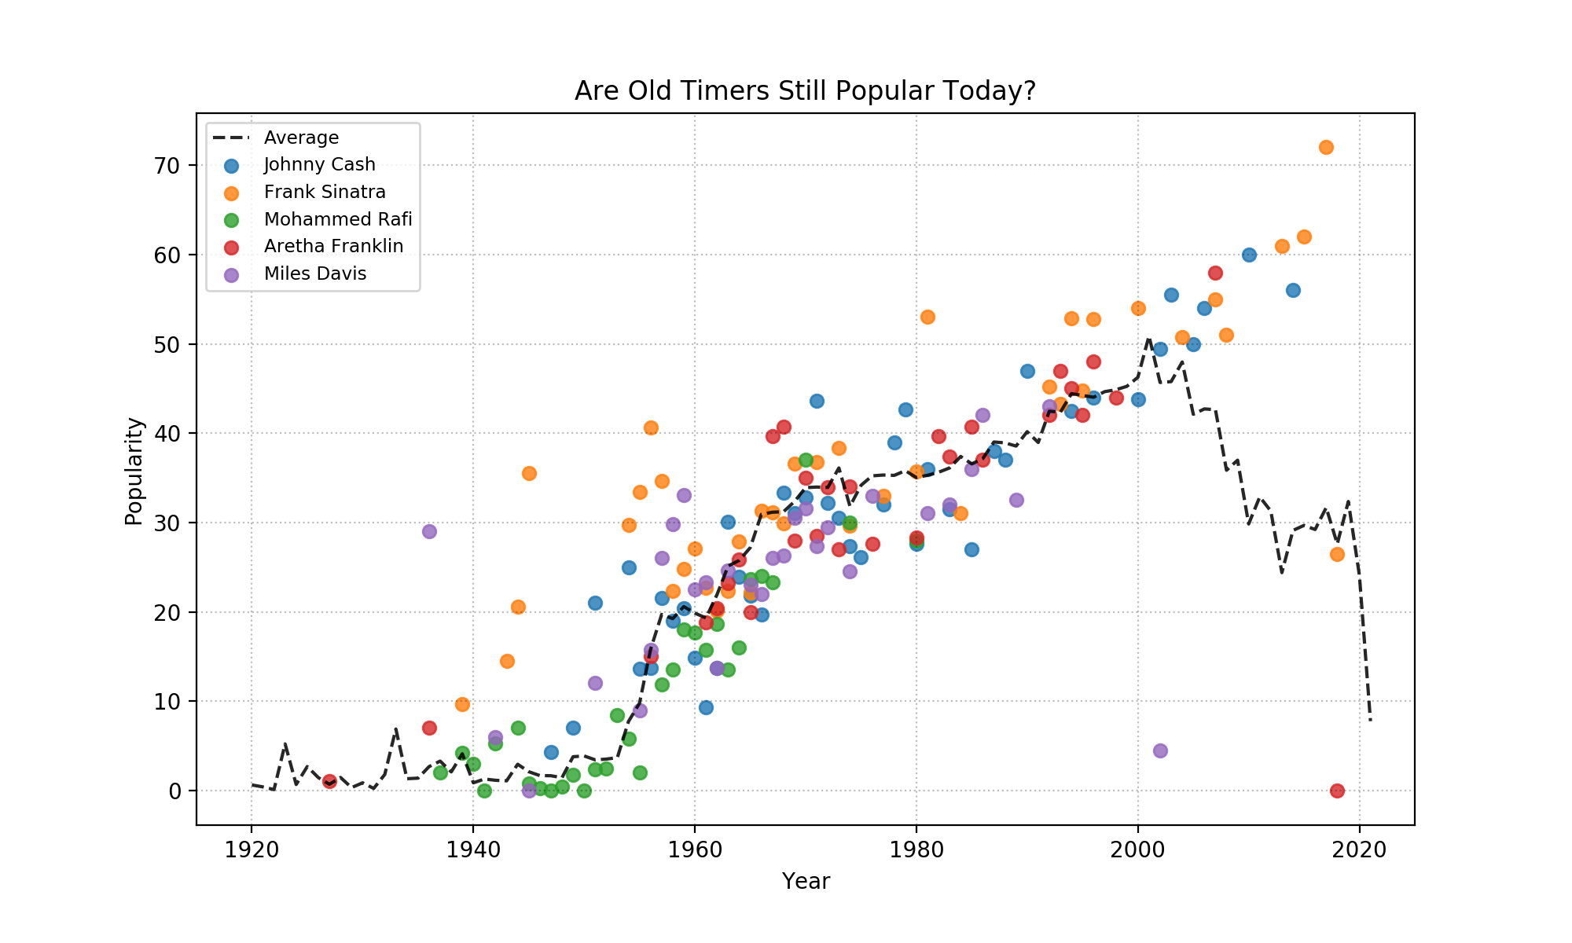
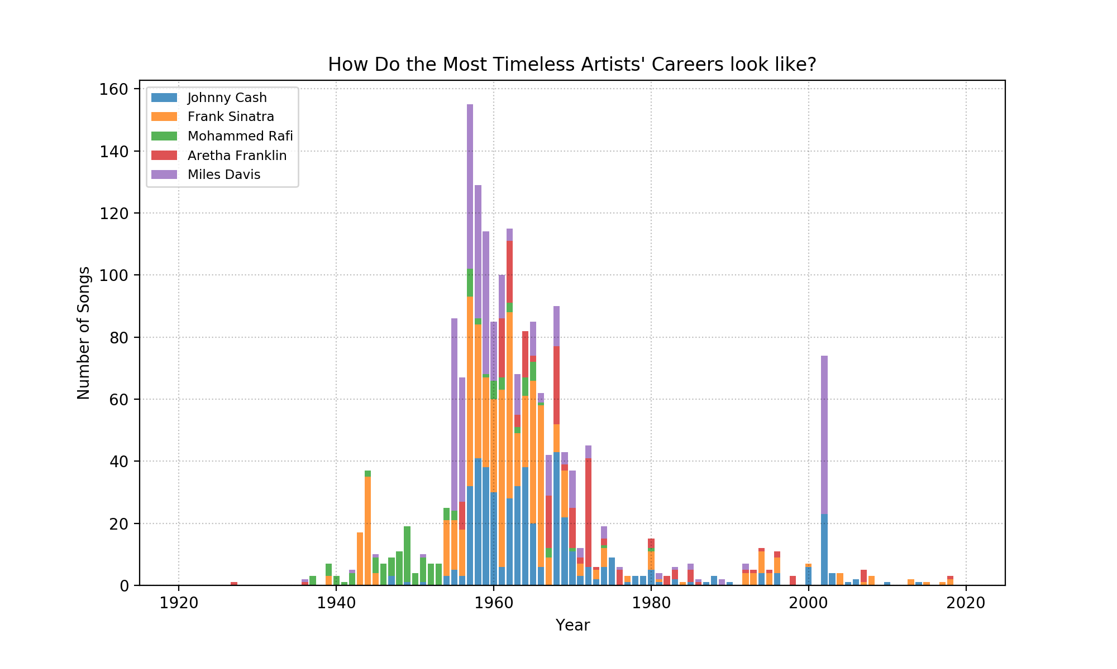
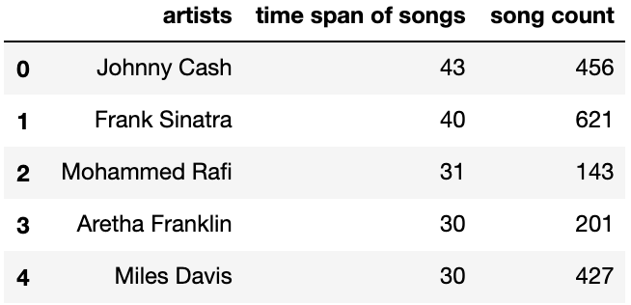
(Who are the most timeless artists?)
Analysis: Who is the music GOAT?
Notes:
Tianchi:
Johnny Cash → Years active: 1954–2003
Born: 1932; Died: 2003
Cash is one of the best-selling music artists of all time, having sold more than 90 million records worldwide.
“Hurt” → Came out in 2002
Frank Sinatra → Died in 1998

Slide 19
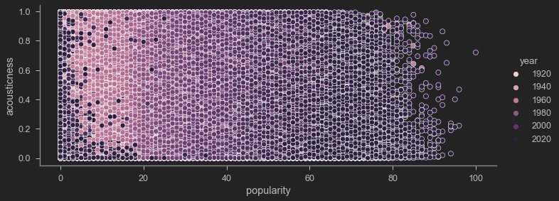
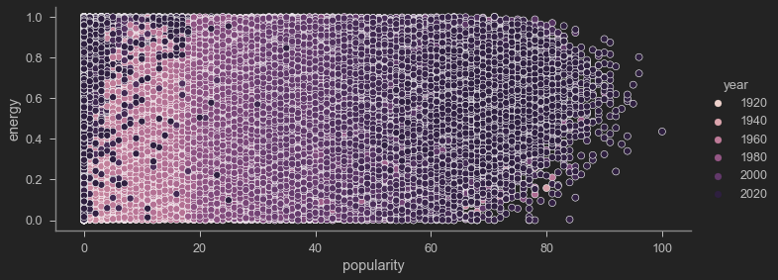
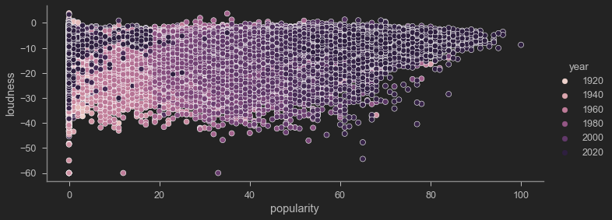
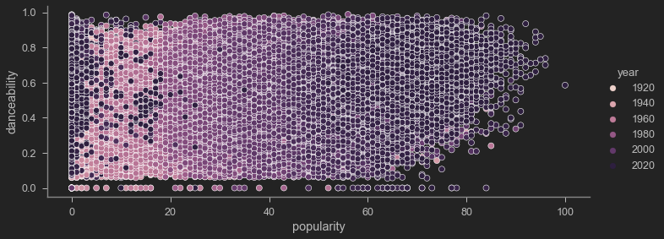
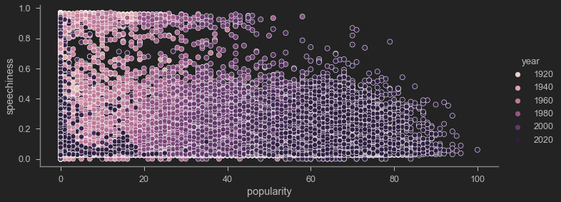
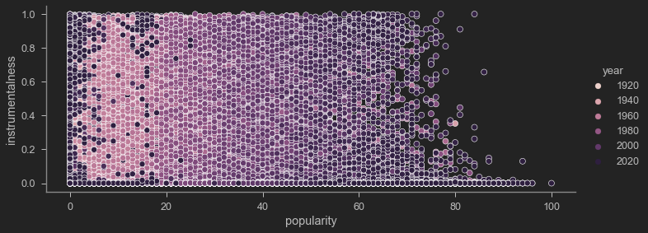
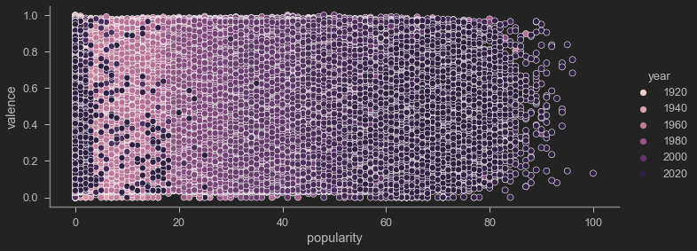
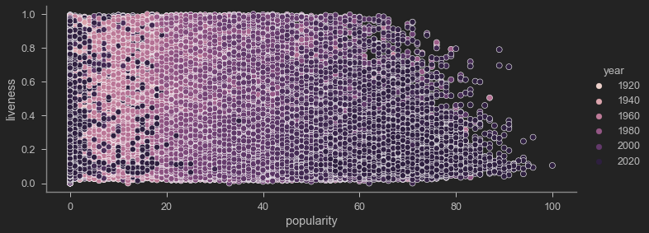
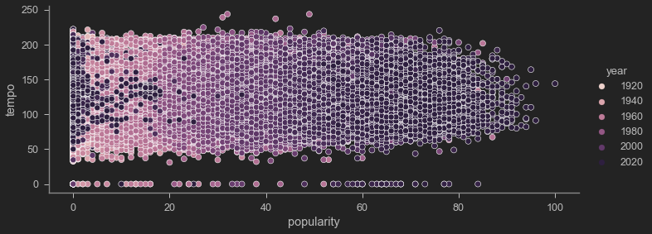
Scatter Plots - Popularity vs. Audio Features

Slide 20
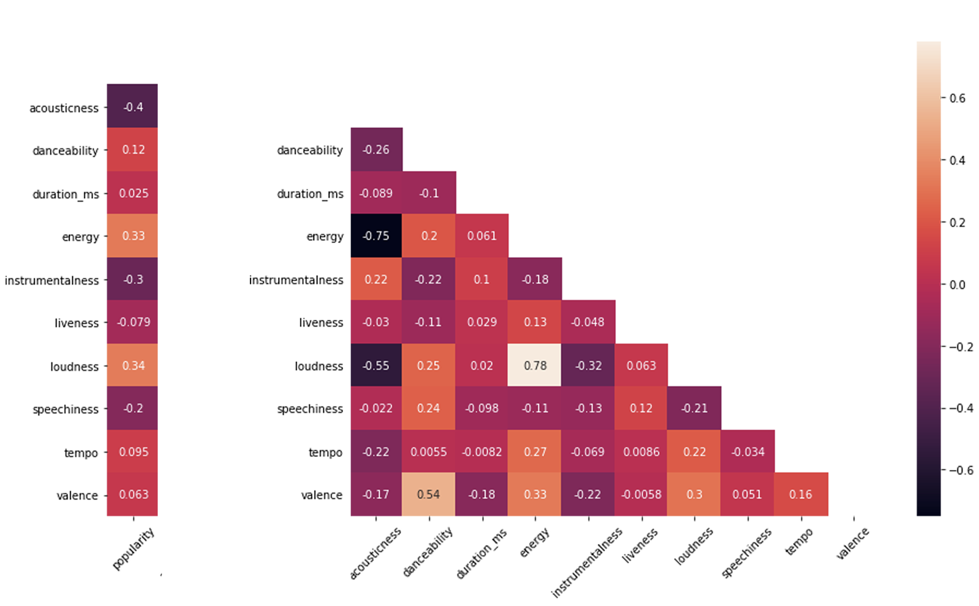
Are there interdependent relationships between different audio features ?
Acousticness vs Popularity
Loudness and Popularity/Energy
Acousticness vs. Energy/Loudness
Loudness vs. Energy
Danceability vs. Valence
Notes:
Aaron :
Acoustic music is music that solely or primarily uses instruments that produce sound through acoustic means, as opposed to electric or electronic means.

Slide 21
Key Findings/Conclusions
Music characteristics appear to have evolved over time and began stabilizing around 1960
Major genres have similar music characteristics like tempo, but some divergence noted for explicit and accousticness variables
No single music characteristic can predict a song’s popularity; some covariance found amongst the characteristics
Multiple linear or nonlinear regression an interesting next step towards predicting music popularity but not explored.
Songs from the late 1990s to the early 2000s are the hottest on Spotify.
Music’s legends continue to be popular today
Notes:
Jeremy

Slide 22
Thanks!
Any questions?

Slide 23
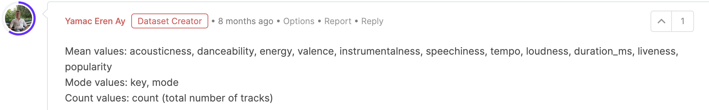
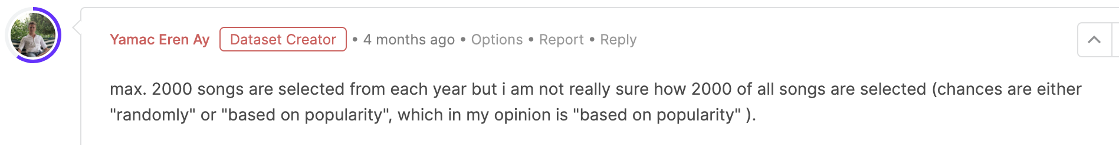
Appendix - Data Limitation
Lists of collaborators such as (['JAY-Z', 'The Notorious B.I.G.']) makes analysis tricky
Genres were loaded as lists of values and are sorted alphabetically, making it hard to determine popular genre trends
Popularity is a subjective measure. It’s based on current episodes of listening by contemporary listeners
Data collection methodology not exactly clear, especially when accounting for noisy data in early 20th century

